Slide 1

Retail Sales Analysis for Business Optimization
Assignment 2 – MDA512 | Group 4
Lecturer: Dr. Samar Shailendra

Slide 2

Problem Statement & Background
Retail businesses rely on data to inform decisions on inventory, marketing, and customer targeting.
This project analyses 2023 retail sales data to uncover trends by category, customer demographics,
and seasonality. It also uses machine learning to predict high-value transactions and sales amounts.

Slide 3


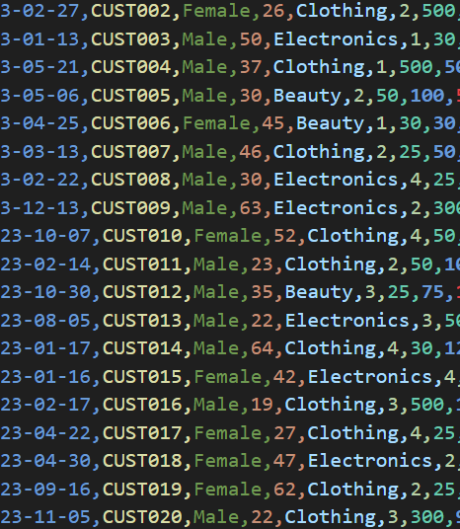
Dataset & Tools
Dataset: 1,000 retail transactions from Kaggle (2023)
Attributes: Date, Gender, Age, Category, Quantity, Price, Total Amount
Preprocessing:
Date parsing, Month/Year extraction, Category/Gender encoding
Tools: Python, pandas, matplotlib, scikit-learn

Slide 4
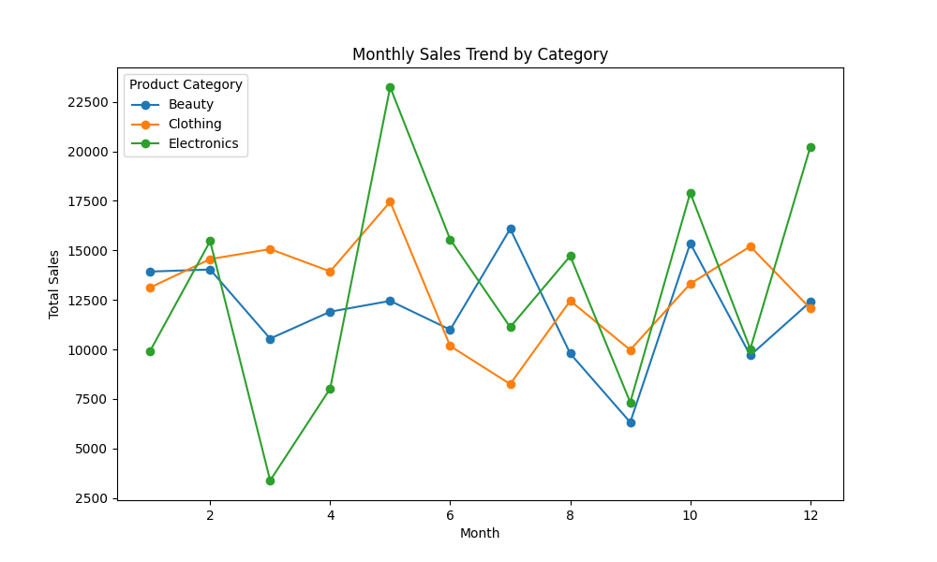
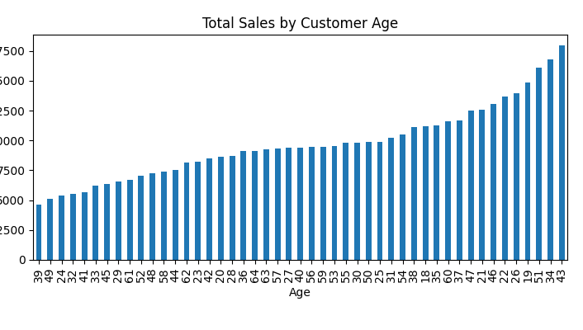

Research Questions & Business Model
Which categories generate the highest sales?
How do age/gender affect sales?
What are seasonal trends?
Can we predict high-value transactions?
Business Model: Use data to guide stock, marketing, and customer segmentation

Slide 5
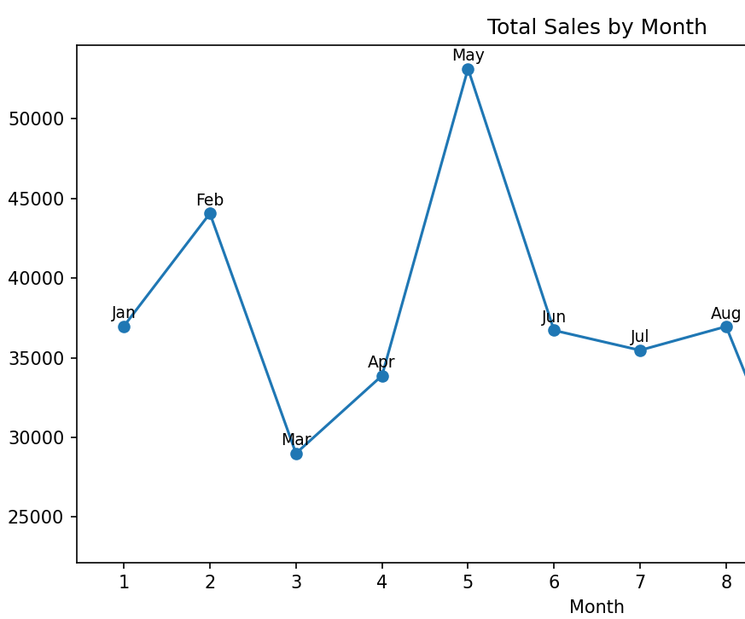
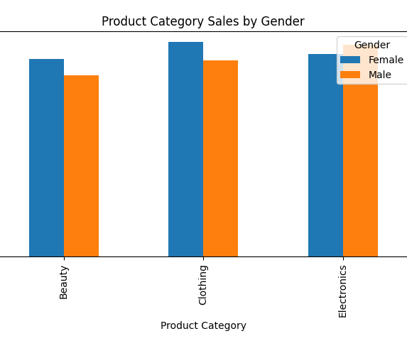
Key Insights from Visual Analysis
Clothing & Electronics are top categories
Middle-aged customers (30–50) spend the most
May & December peak in sales
Females outspend males, especially in Beauty
Insights help with targeting promotions by age & season

Slide 6
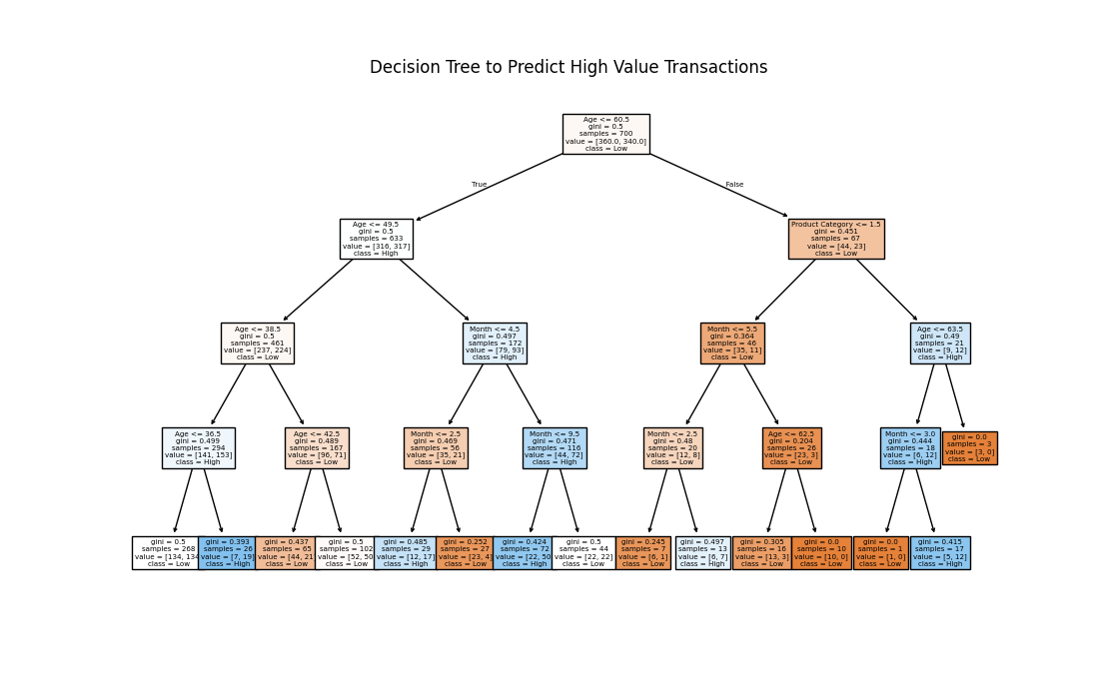
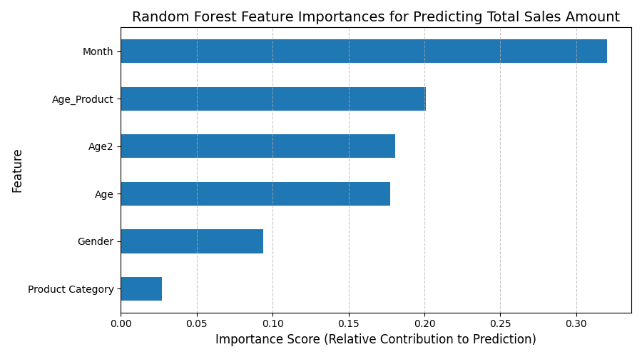
Predictive Modeling
1. Decision Tree Classifier:
- Predicts High vs Low Value transactions
- Key split: Age, Product Category, Month
2. Random Forest Regressor:
- Predicts sales amount
- Important features: Month, Age*Category interaction, Age squared

Slide 7
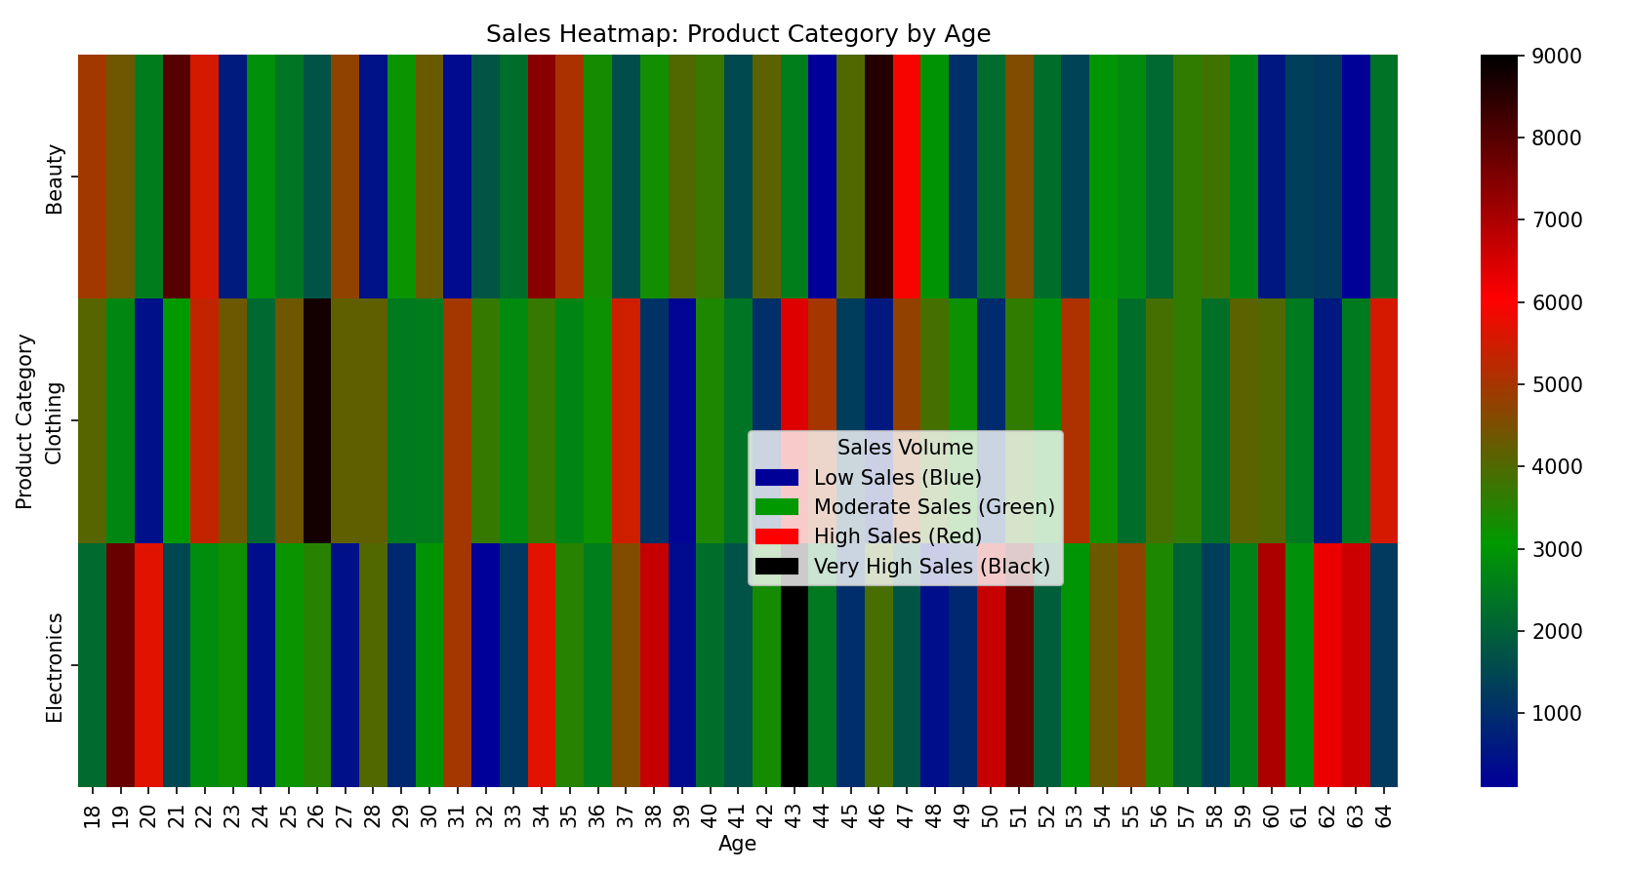
Conclusion & Recommendations
Focus
Focus inventory and marketing on top-selling categories and peak months
Target
Target 30–50 age group with high basket sizes
Use
Use models to predict high-value buyers and plan promotions
Combine demographic and seasonal patterns for strategic decisions
Combine
Thank You

